Slide 1



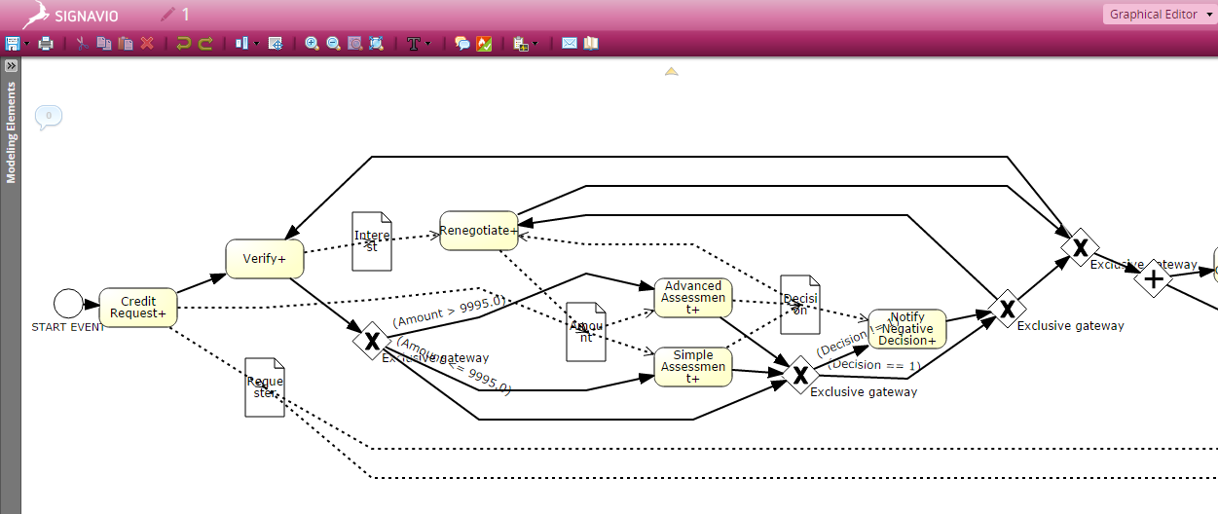
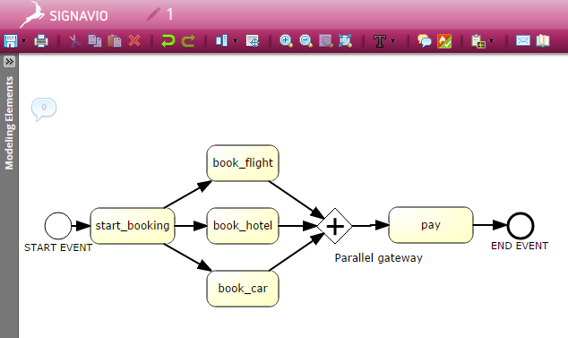
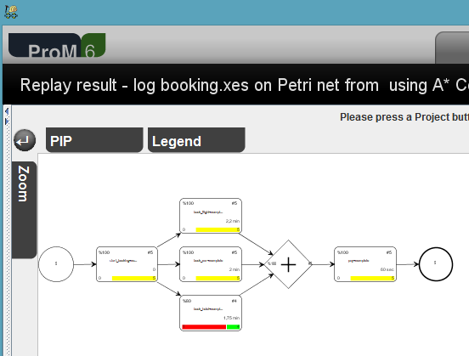
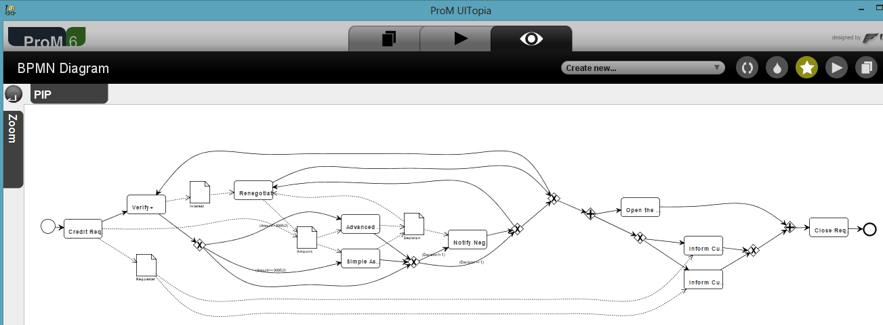
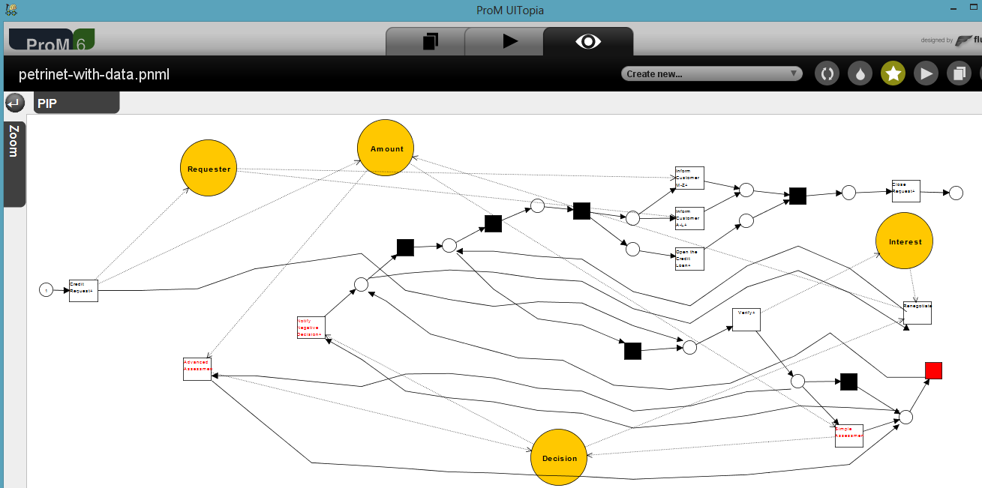
Discovering, Analyzing and Enhancing
BPMN Models Using ProM
  ProM supports a basic set of BPMN modeling elements and constructions
    Import and export of BPMN diagrams
  BPMN models can be discovered by applying conversion algorithms
  BPMN model can be analyzed and enhanced with additional conformance and performance information
Anna A. Kalenkova Massimiliano de Leoni Wil M.P. van der Aalst
September 10 2014 BPM 2014

